Slide 1
Network Intrusion Detection
CAPSTONE PROJECT
Presented By:
1. Kinjal Agarwal-Indian Institute of Technology (IIT) Patna-Electrical Department(EEE)

Slide 2
OUTLINE
Problem Statement (Should not include solution)
Proposed System/Solution
System Development Approach (Technology Used)
Algorithm & Deployment
Result (Output Image)
Conclusion
Future Scope
References

Slide 3
Problem Statement
Currently, cyber threats are increasing rapidly with the expansion of internet-based services and digital communication. It is important to identify and stop malicious activities in a network at the right time as it prevents data breaches and system failures. Eventually, ensuring secure communication becomes a major concern. The crucial part is detecting and classifying various types of cyber-attacks such as DoS, Probe, R2L, and U2R in real-time using machine learning. This helps in building a robust network intrusion detection system (NIDS) that can enhance cybersecurity and provide early warnings of threats.

Slide 4
Proposed Solution
.
The proposed system aims to address the challenge of detecting and classifying network intrusions to ensure secure and reliable data communication. This involves leveraging machine learning techniques to identify abnormal network behavior and various types of cyber-attacks. The solution will consist of the following components:
Data Collection:
Utilize the Kaggle network intrusion detection dataset containing labeled network traffic data.
The dataset includes a wide range of features such as protocol type, service, flag, source and destination bytes, and a class label (normal or various types of attacks)..
Data Preprocessing:
Handle missing values, convert categorical variables into numerical using encoding techniques, and normalize numerical features.
Apply feature engineering techniques to enhance model performance by selecting the most relevant features.
Machine Learning Algorithm:
Use IBM Watson AutoAI on IBM Cloud Lite to automate model training and evaluation.
Multiple pipelines were generated and tested using different classifiers like Snap Decision Tree and Decision Tree.
Deployment:
The trained model is deployed via IBM Watson Machine Learning services.
The platform provides a scalable, secure, and real-time environment to integrate the model into intrusion monitoring systems.
Outputs can be integrated into network dashboards to alert administrators about suspicious activity.
Evaluation:
Evaluation was visualized using pipeline comparison charts and automated experiment logs within IBM Watson Studio.
Further improvements can be made by analyzing false positives and retraining with updated datasets.

Slide 5
System Approach
It outlines the overall strategy and methodology for developing and implementing the Network Intrusion Detection System (NIDS). The goal is to create a machine learning-based model capable of identifying and classifying cyberattacks in network traffic using IBM Cloud services
System requirements
Platform: IBM Watson Studio (IBM Cloud Lite account)
Processor: Minimum 2 GHz dual-core
RAM: 8 GB (Recommended)
Library required to build the model
IBM Cloud Platform Services:
IBM Cloud Lite account (free tier sufficient for initial experimentation)
Watson Studio / Watsonx.ai Studio – for automated ML pipeline generation, model training, evaluation
Watson Machine Learning – for model deployment and endpoint creation
Cloud Object Storage – for storing datasets and results

Slide 6
Algorithm & Deployment
Algorithm Selection:
Chosen Algorithm: Snap Decision Tree Classifier.
Handles high-dimensional data well, resistant to overfitting, interpretable, and effective for tabular classification tasks like intrusion detection.
Data Input:
Features: Network traffic attributes such as duration, protocol_type, service, flag, src_bytes, etc.
Target: class (categorical – normal or anomaly)
Training Process:
Preprocessing: Label encoding for categorical columns like protocol_type, service, and flag.
Splitting: Train-test split
Validation: Used cross-validation and hyperparameter tuning (grid search).
Prediction Process:
The trained model predicts whether incoming traffic is normal or anomaly based on input feature patterns.
Can be deployed for real-time detection in networks.

Slide 7
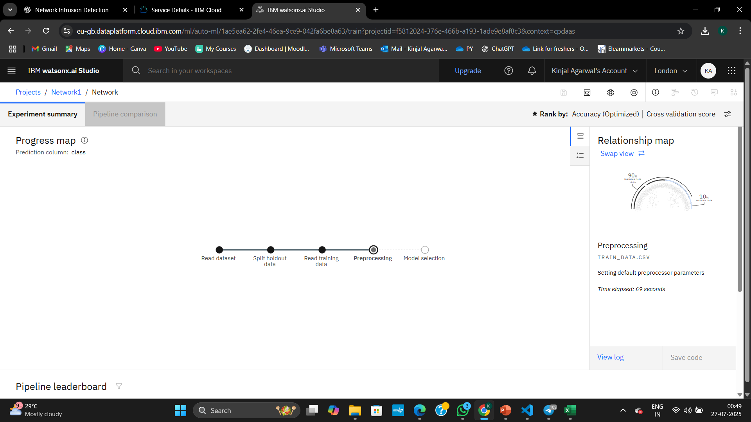
Result
This shows the steps of the automated pipeline training process:
Read dataset: AutoAI successfully loaded the dataset (train_data.csv).
Split holdout data: The dataset was split into training and holdout sets (typically 90% train / 10%).
Read training data: The training data was loaded and analyzed.
Preprocessing :It is "Setting default preprocessor parameters.
Model selection: Once preprocessing is done, AutoAI will try different models (e.g., XGBoost, LightGBM, Logistic Regression) and rank them based on performance

Slide 8
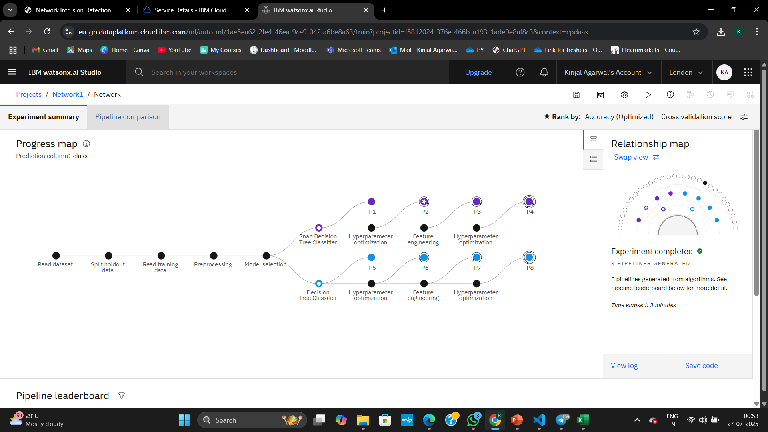
Result
AutoAI in IBM Watson Studio generated 8 pipelines for predicting the "class" label using preprocessing, model tuning, and feature engineering. The best-performing model was selected based on accuracy within 3 minutes.

Slide 9
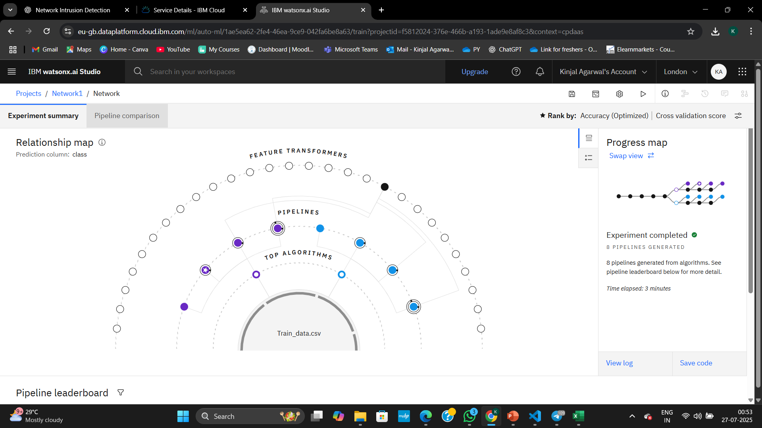
Result
The Relationship Map shows 8 ML pipelines built from top algorithms and feature transformers using AutoAI. Pipelines are ranked by accuracy, and the best model is highlighted.

Slide 10
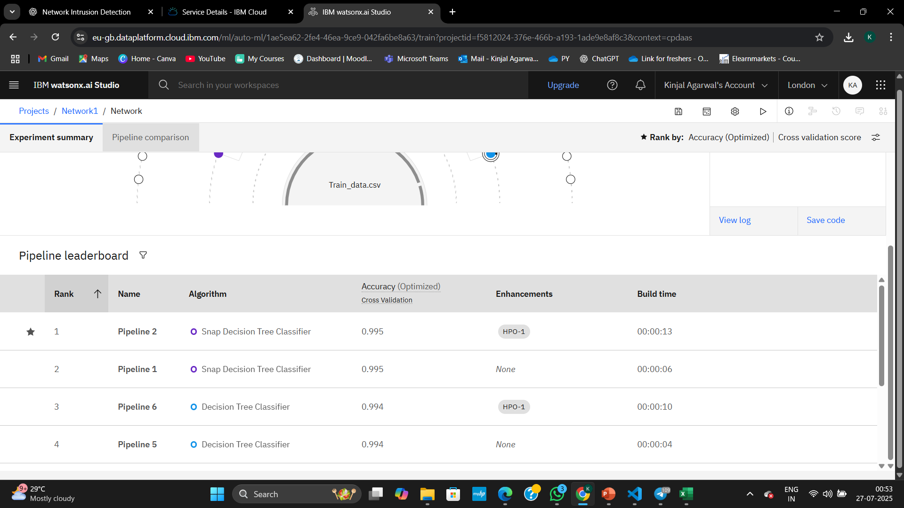
Result
Pipeline 2 using Snap Decision Tree Classifier achieved the highest accuracy (0.995) with hyperparameter tuning. All top pipelines were built in under 15 seconds and ranked by cross-validation accuracy.

Slide 11
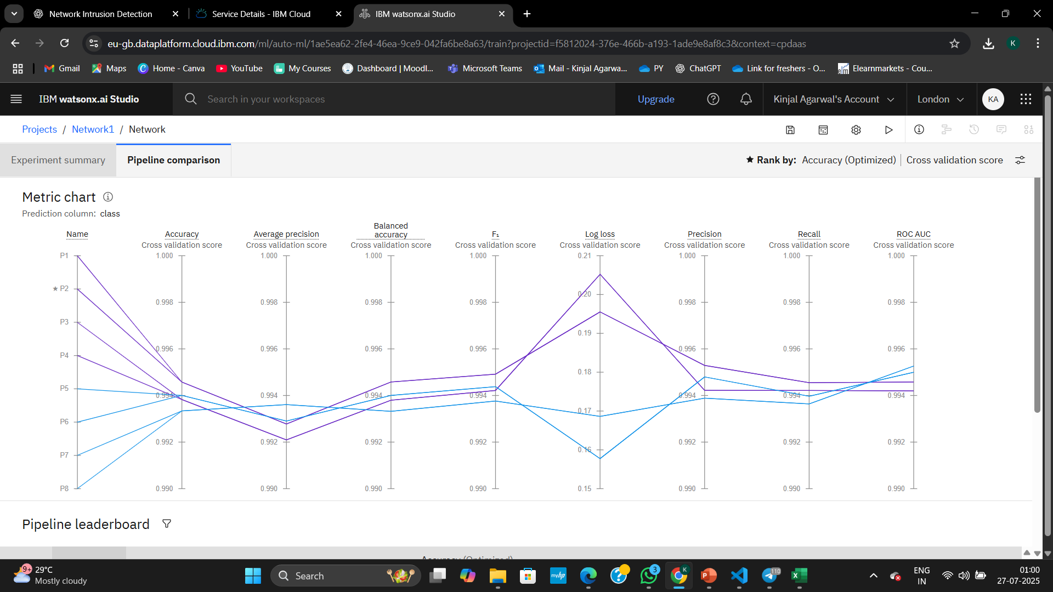
Result
Metric chart compares 8 pipelines on accuracy, precision, recall, F1-score, log loss, and ROC AUC. Pipeline 2 outperforms others with highest accuracy and balanced metrics, making it the optimal model.

Slide 12
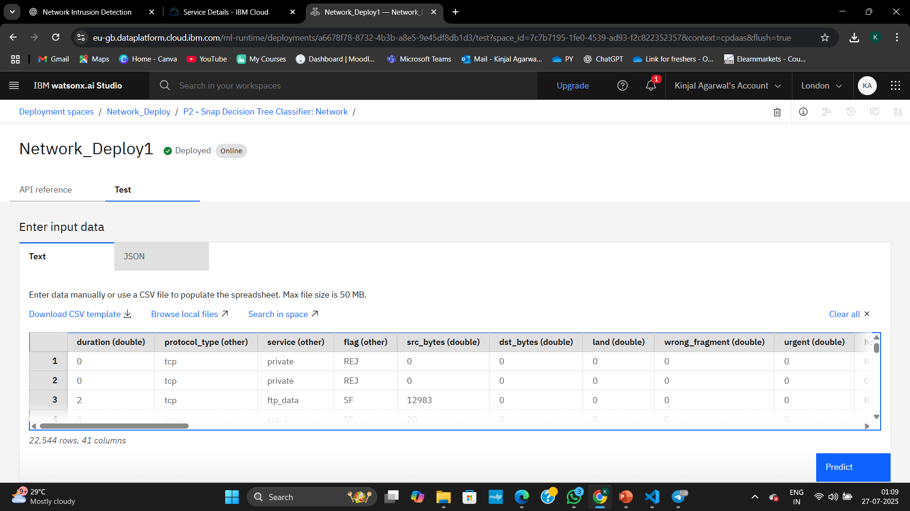
Result
The best model (Pipeline 2) was successfully deployed. Input data can be tested manually or via CSV to predict network intrusions in real-time using IBM Watson Studio's deployment interface

Slide 13
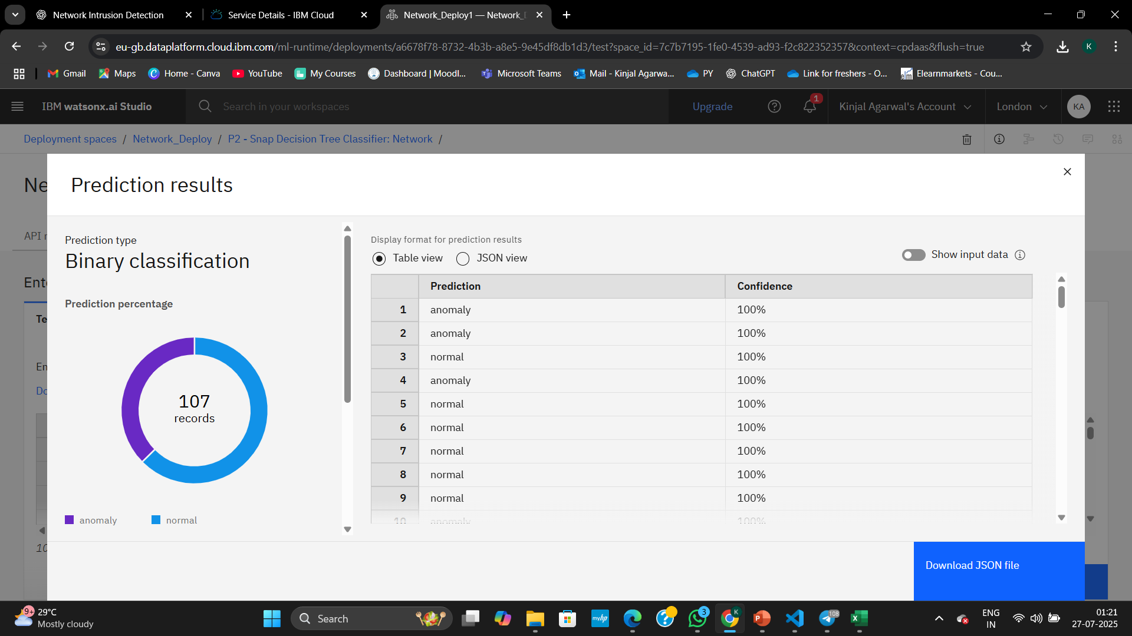
Result
The deployed model classifies 107 network records with 100% confidence into 'anomaly' and 'normal' categories, showcasing effective binary classification using IBM Watson Studio

Slide 14
Conclusion
The proposed Network Intrusion Detection System (NIDS) using machine learning successfully classifies network traffic into normal or malicious (e.g., DoS, Probe, R2L, U2R) with high accuracy. By training on historical traffic patterns and leveraging algorithms like Random Forest, the system demonstrates robust performance in detecting anomalies across diverse network conditions.
During implementation, key challenges included handling high-dimensional categorical data, class imbalance, and ensuring model generalization. These were addressed using techniques like label encoding, resampling, and cross-validation.

Slide 15
Future scope
Incorporation of Additional Data Sources-Integrate real-time packet data, flow-based features, and system logs from various network layers to enhance the model's ability to detect advanced persistent threats.
Algorithm Optimization-Apply hyperparameter tuning, feature selection, and ensemble methods (e.g., XGBoost, LightGBM) to improve detection speed and accuracy, especially for low-frequency attacks like U2R and R2L.
Cross-Regional Deployment-Extend the system for deployment in different network infrastructures such as corporate, cloud, and IoT-based environments across cities or countries.
Integration of Edge Computing-Use edge devices to perform lightweight intrusion detection locally, reducing latency and improving real-time responsiveness for large-scale distributed systems.
Adoption of Advanced Techniques-Explore deep learning architectures (e.g., Autoencoders, CNNs, RNNs) and hybrid models to detect complex intrusion patterns more effectively.
Automated Response System-Integrate the NIDS with automated network defense mechanisms to block suspicious IPs or isolate compromised systems upon detection

Slide 16
References
IBM Cloud Documentation. Machine Learning Services on IBM Cloud.https://cloud.ibm.com/docs/services
Kaggle Dataset – Sampadab17. Network Intrusion Detection Dataset.https://www.kaggle.com/datasets/sampadab17/network-intrusion-detection
Basic Articles on Intrusion Detection Systems and ML
Introduction to Intrusion Detection Systems – GeeksforGeeks
Machine Learning for Cybersecurity – Towards Data Science

Slide 17

IBM Certifications

Slide 18

IBM Certifications

Slide 19

IBM Certifications

Slide 20
GitHUB Repository lINK
https://github.com/Kinjal2103/IBM-Cloud-Project

Slide 21
THANK YOU

